Slide 1


KS4 Mathematics
D5 Grouping continuous data

Slide 2
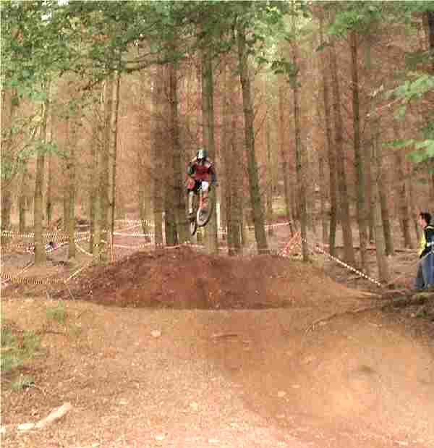

Analysing data
Tom is a sixteen-year-old who regularly takes part in downhill cycle races. He records the competitors’ race times on a spreadsheet.
His best time is 101.6
seconds.
How accurately has he measured this time?
Is the data continuous or discrete?
Notes:
The real data used in this presentation was collected by Tom Pye at a race at Aston Hill, Bucks.
Encourage pupils to refer back to previous work on averages, graphs and types of data.
Emphasise the size of the data set; guide them towards grouping the data.
Remind pupils that the larger the number the slower the speed.

Slide 3

Analysing data
Here are some race times in seconds from a downhill
racing event.
88.4 91.5 92.1 93.3 93.9 94.7 95.0 95.3 95.5
95.6 95.6 96.3 96.5 96.9 97.0 97.0 97.0 97.3
97.4 97.4 97.7 97.8 98.0 98.2 98.2 98.4 98.4
98.5 98.9 99.0 99.1 99.6 99.6 99.8 100.0 100.6
100.6 101.1 101.4 101.4 101.5 101.6 101.6 101.8 101.9
102.1 102.5 102.6 102.7 103.1 103.1 103.1 104.1 105.0
105.2 105.6 105.6 105.7 105.8 105.9
If you wanted to analyze the boys’ performance, what could you do with the data?
How easy is the format of the data to analyze at the moment? Can you draw any conclusions?
Notes:
It is advisable to print out slides with large sets of data for ease of use by pupils.
Encourage pupils to refer back to previous work on averages and graphs if appropriate.
Emphasise the size of the data set; guide them towards grouping the data.
Remind pupils that the larger the number the slower the speed.

Slide 4
Choosing the right graph
In a piece of GCSE coursework, a student used a spreadsheet program to produce a graph of the race data.
This is the graph he printed.
What labels could be added to the axes?
110.0
105.0
100.0
What does the graph show?
95.0
90.0
85.0
Is it an appropriate graph?
80.0
Notes:
Pupils should realize that each bar represents one data item. Since the data is in ascending order, the bars gradually increase in height. The horizontal axis represents the riders 1 – 60; the vertical axis the race times.
The graph should illustrate the problems of using a spreadsheet without full understanding. Suggest that grouping the data might help to see general trends and an overall picture. Ask what the class intervals should be.
Point out that when the data is grouped, the times will go on the horizontal axis and frequency on the vertical axis.

Slide 5
Grouping data
A list of results is called a data set.
It is often easier to analyze a large data set if we put the data into groups. These are called class intervals.
A frequency diagram or histogram can then be drawn.
You will need to decide on the size of the class interval so that there are roughly between 5 and 10 class intervals.
What is the best size for the class intervals for the race times data?
Notes:
On the next page the results are shown again to aid discussion.
Ask pupils what the shortest and fastest times are.
It is appropriate for the interval to be a multiple of 5 or 10 if possible. The best interval here would be 5 seconds.

Slide 6
class intervals
88.4 91.5 92.1 93.3 93.9 94.7 95.0 95.3 95.5
95.6 95.6 96.3 96.5 96.9 97.0 97.0 97.0 97.3
97.4 97.4 97.7 97.8 98.0 98.2 98.2 98.4 98.4
98.5 98.9 99.0 99.1 99.6 99.6 99.8 100.0 100.6
100.6 101.1 101.4 101.4 101.5 101.6 101.6 101.8 101.9
102.1 102.5 102.6 102.7 103.1 103.1 103.1 104.1 105.0
105.2 105.6 105.6 105.7 105.8 105.9
The times roughly range from 85 to 110 seconds.
110 – 85 = 25 seconds.
Suppose we decide to use class intervals with a width of 5 seconds.
25 ÷ 5 = 5 class intervals

Slide 7
Notation for class intervals
How should the class intervals be written down?
Times in seconds | Frequency
85 – 90
90 – 95
95 – 100
100 – 105
105 - 110
What is wrong with this table?
Notes:
Discuss where 90 and 105 should go. The table is ambiguous. For discrete data it would be possible to edit the table to say 86 – 90, 91 – 95, 96 – 100, 101 – 105 etc (or 85 – 89, 90 – 94 etc) but for continuous data this would not work.

Slide 8
Notation for class intervals
Can you explain what the symbols in the middle column mean?
Times in seconds
Times in seconds
Frequency
85 – 90 but not including 90
85 ≤ t < 90
90 – 95 but not including 95
90 ≤ t < 95
95 – 100 but not including 100
95 ≤ t < 100
100 – 105 but not including 105
100 ≤ t < 105
105 – 110 but not including 110
105 ≤ t < 110
Notes:
Discuss where 90, 95 etc would go in this table. Represent the inequality on a number line. Ask pupils where numbers such as 99.9999999 would go.
Note that the data has been rounded off to 1 d.p. so it could be argued that we could write the intervals as 85.0 – 89.9, 90.0 – 94.9 etc but this would imply that the data is discrete, so this would be incorrect.

Slide 9
Notation for class intervals
85 ≤ t < 90 means “times larger than or equal to 85 seconds and less than 90 seconds”
Another way to say this is “from 85 up to but not including 90”
Can you say these in both ways?
1) 90 ≤ t < 95
“times larger than or equal to 90 seconds and less than 95 seconds” or
“from 90 up to but not including 95”.
2) 105 ≤ t < 110
“times larger than or equal to 105 seconds and less than 110 seconds” or
“from 105 up to but not including 110”.
Notes:
Pupils could work together in pairs to practise the correct use of vocabulary.

Slide 10
Class intervals
88.4 91.5 92.1 93.3 93.9 94.7 95.0 95.3 95.5
95.6 95.6 96.3 96.5 96.9 97.0 97.0 97.0 97.3
97.4 97.4 97.7 97.8 98.0 98.2 98.2 98.4 98.4
98.5 98.9 99.0 99.1 99.6 99.6 99.8 100.0 100.6
100.6 101.1 101.4 101.4 101.5 101.6 101.6 101.8 101.9
102.1 102.5 102.6 102.7 103.1 103.1 103.1 104.1 105.0
105.2 105.6 105.6 105.7 105.8 105.9
Times in seconds
Frequency
85 ≤ t < 90
1
90 ≤ t < 95
5
Use the data to fill in the table.
95 ≤ t < 100
28
100 ≤ t < 105
19
105 ≤ t < 110
7
Notes:
Pupils would benefit from having a print out of the data to avoid missing out data items. A tally could be used if required.
They should check they have 60 items in total in the frequency column.

